Slide 1
Design Patterns
Hardeep Kaur Dhalla

Slide 2
Design patterns
Time proven best software design practices.
Software design patterns fall into 3 categories
Creational patterns
Structural patterns
Behavioral patterns

Slide 3
Creational design patterns
They are concerned with the object instantiation.
Some popular and common patterns are
Singleton
Prototype
Factory
Builder
Abstract Factory

Slide 4
Structural design patterns
These design patterns are concerned about the class and object composition.
Inheritance is used to design interfaces and classes in the application to add new functionalities.
Some popular and common patterns are
Decorator
Facade
Adapter

Slide 5
Behavioral Patterns
These design patterns are specifically concerned with communication between objects and define their behavior within the application.
Some popular and common patterns are
Observer
Visitor
Template
Iterator

Slide 6
Singleton pattern
Ensure a class has only one instance and provide a global point of access to it.
The classes java.lang.System, java.lang.Runtime, and java.sql.DriverManager are examples of the Singleton pattern.
Implemented with private constructor and public static getInstance method.

Slide 7
Prototype
Cloning of objects while keeping performance in mind.
This pattern is used when creation of object directly is costly. For example, when database calls, network trips etc. are involved in creating objects.
https://www.journaldev.com/1440/prototype-design-pattern-in-java

Slide 8
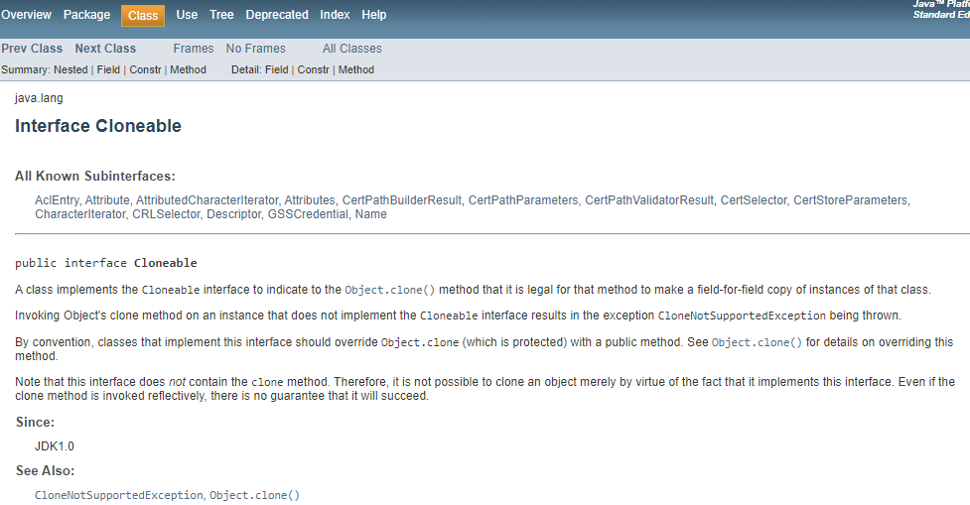
Prototype Pattern
https://docs.oracle.com/javase/7/docs/api/java/lang/Cloneable.html

Slide 9
Factory pattern
In Factory pattern, we create object without exposing the creation logic to the client and refer to newly created object using a common interface.

Slide 10
Builder pattern
Separate the construction of a complex factory from its representation so that the same construction process can create different representations.
Avoid overloading constructors with large number of parameters.
Create a separate builder class to help initialize objects of class in different possible ways.

Slide 11
Front Controller design pattern
The controller provides a centralized entry point that controls and manages Web request handling.
This handler can do the authentication or authorization or logging or tracking of request and then pass the requests to corresponding handlers.
https://www.oracle.com/java/technologies/front-controller.html

Slide 12
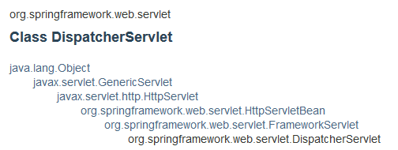
Dispatcher Servlet
Central dispatcher which dispatches to registered handlers for processing a web request, providing convenient mapping and exception handling facilities.
https://docs.spring.io/spring-framework/docs/current/javadoc-api/org/springframework/web/servlet/DispatcherServlet.html

Slide 13
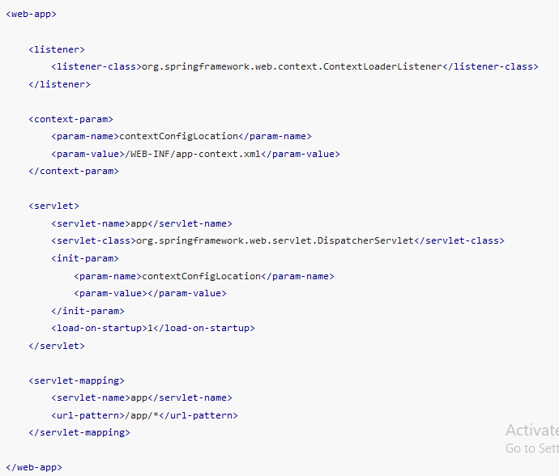
XML based configuration

